Slide 1
INTERNSHIP-PHASE 1 REVIEW
Student Name: Sanoop A
SRN: R21EH160
Section: AI & DS ‘C’
School of Computer Science and Engineering

Slide 2
COGNIZANT TECHNOLOGY SERVICES :
INDUSTRIAL GUIDE: Akash Nair (Cognizant)
DETAILS OF INTERNAL GUIDE : Dr. Mayuri Kundu

Slide 3
Contents
Introduction
Objective of Industrial Training
Company Profile
Description of the Project/Work
Technology Implementation (Hardware & Software)
Roles and Responsibilities
Conclusion

Slide 4
Introduction
Foundation of Data Engineering: Focuses on building and optimizing data pipelines and infrastructures to unlock data’s full potential.
Role of Cognizant: A global leader offering hands-on learning in cutting-edge tools like cloud platforms and big data technologies.
Internship Highlights: Practical experience with real-world projects under the guidance of industry experts.
Skill Development: Enhances technical expertise, problem-solving abilities, and practical knowledge in data engineering.
Career Impact: Prepares participants for a successful and rewarding career in the evolving field of data engineering.

Slide 5
Objective of Industrial Training
Practical Knowledge: To gain hands-on experience with data engineering tools, technologies, and methodologies.
Problem-Solving Skills: To develop the ability to design, build, and optimize data pipelines to address real-world business challenges.
Technical Expertise: To learn about cloud platforms, big data processing, database management systems, and ETL (Extract, Transform, Load) processes.
Industry Exposure: To understand best practices and standards by working alongside industry experts on live projects.
Career Preparedness: To bridge the gap between theoretical knowledge and practical applications, enhancing employability in the field of data engineering.

Slide 6
Company Profile
Overview: Cognizant is a leading global professional services company specializing in IT, consulting, and business process outsourcing.
Headquarters: Based in Teaneck, New Jersey, USA, with operations spanning across the globe.
Core Services: Focuses on digital transformation, cloud computing, data engineering, artificial intelligence, and software development.
Market Presence: Serves clients in diverse industries, including healthcare, finance, retail, and technology.
Workforce Strength: Boasts a large, skilled workforce with a strong emphasis on fostering innovation and talent development.
Commitment to Excellence: Recognized for delivering cutting-edge solutions to help businesses stay competitive in the digital era.

Slide 7
DESCRIPTION OF THE PROJECT/WORK
Overview: Informatica PowerCenter is a powerful data integration tool widely used for ETL (Extract, Transform, Load) processes.
ETL Process: It enables the extraction of data from diverse sources, transformation of data into a usable format, and loading it into target systems like data warehouses or databases.
Key Features:
Supports a variety of data sources and formats. Provides robust transformation capabilities for data cleansing, aggregation, and enrichment.
Ensures high scalability and performance for handling large datasets.
Advantages: Simplifies complex data workflows with a user-friendly interface. Offers automation and monitoring tools for efficient data pipeline management. Ensures data quality and consistency throughout the ETL process.

Slide 8
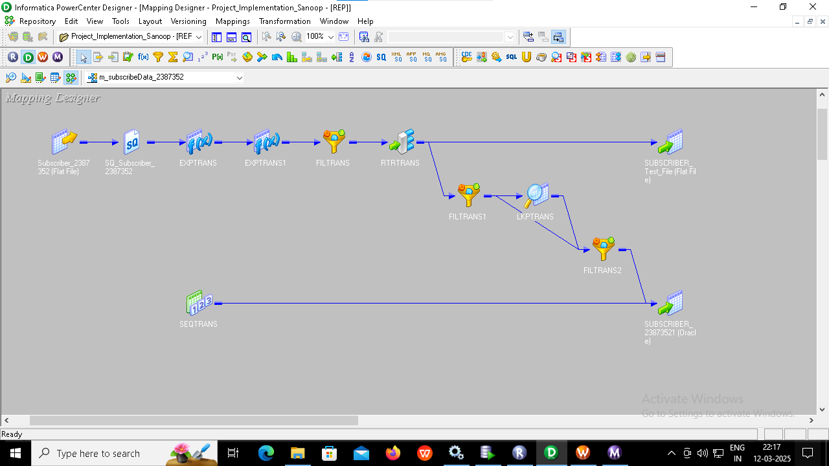
Technology Implementation (Hardware & Software)

Slide 9
Roles and Responsibilities
As a Data Engineering Intern at Cognizant, my responsibilities would include utilizing tools like Unix, SQL, Python, and Informatica PowerCenter to manage and process data efficiently. I would work on data extraction and transformation, writing SQL queries to manipulate datasets and using Unix commands to handle server-side data operations.
A key aspect of my role would involve designing and implementing ETL workflows in Informatica PowerCenter to facilitate seamless data integration. Additionally, I would write Python scripts for automating tasks and processing data while working with XML and JSON formats to ensure smooth data exchange.
Exposure to cloud fundamentals will be vital as I learn the basics of managing data storage, processing, and deployments on cloud platforms. I would also focus on ensuring data validation and quality assurance by creating scripts and performing checks for accuracy and consistency. My role may also involve collaboration with cross-functional teams to understand requirements and providing solutions. This internship offers a strong foundation in data engineering while honing your skills with industry-relevant tools.

Slide 10
Conclusion
An internship as a Data Engineer at Cognizant provides valuable hands-on experience in data engineering.
I work with essential tools like Unix, SQL, Python, Informatica PowerCenter, XML, and JSON.
Gain exposure to cloud fundamentals, learning to manage data in cloud environments.
Build skills in data processing, integration, and automation to solve real-world challenges.
Focus on data validation and quality assurance to ensure data accuracy and consistency.
Collaborate with cross-functional teams, understanding requirements and delivering data solutions.
This internship lays the groundwork for a promising career in data engineering.

